Slide 1
Machine Learning Model for Medical Image Segmentation
Erli Wang
David Nawee
CS-631 T

Slide 2
A Brief Introduction
Convolutional Neural Networks are machine learning programs categorized as deep learning, it is most prominent & powerful in visual image analysis
The idea of CNN comes from biology and the way organisms neural network is neurons interact and work with one another in harmonious relationships
Through the connection of neurons and the use of multiple layers CNN has become one of the most widely applicable methods for image recognition

Slide 3
The problem
In the medical field the process required to identify specific parts of an image is an extremely tedious and delicate procedure
Thanks to machine learning the process has become much smoother and faster than ever before, but is still not perfectly accurate…

Slide 4
Our Project Goal
Our project goal: to use a CNN program that can accurately identify different regions of the knee as a result of image training.
In this project we are attempting to train the program to be able to clearly identify the tibia bone if given an image of the MRI

Slide 5
The step by step process
Data Labeling – labeling MRI images using baseline application
Data Preparation – getting data into the proper format in order to run python unet program
Model Training and testing – setting up and creating npy files. Process model training. Review model training results

Slide 6
Data Labeling
In our project, we labeled the same case files twice
The mini experiment: Does having different people labeling the same cases cause the program to generate similar or dissimilar results.
Data labeling hypothesis: Our results should only differ slightly and the reason being due to human error labeling.

Slide 7
Data Preparation Stage
In the data preparation stage
We manipulated the mask code in order to create a dicom conversion code that converts the images into type tiff
At first, we labeled the newly generated tiff images by hand and renaming the images of 1 case took about 30 minutes
After spending time to develop a code to label the remaining cases it took about 15 minutes to label the remaining case files

Slide 8
Experiments conducted
Experiment One
5 case: 3 training, 1 validation, 1 test
Experiment Two
5 case: 3 training, 1 validation, 1 test
Experiment Three
40 cases: 30 training, 5 validation, 5 test

Slide 9
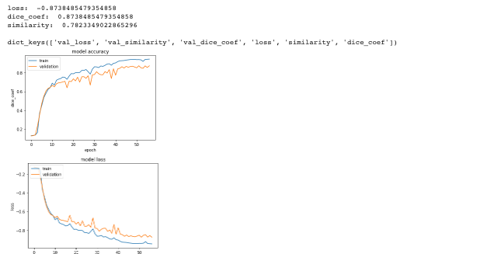
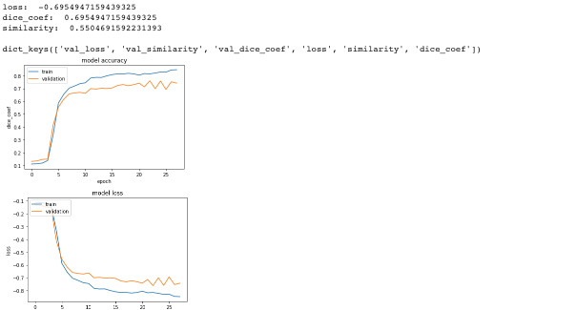
Results from Experiment 1 and 2
David Experiment
Training:
Epoch used: 57/100
Amount of images: 340
Testing:
similarity: 0.7823349022865296
loss: -0.8738485479354858
dice_coef: 0.8738485479354858
Amount of images: 100
Erli Experiment
Training:
Epoch used: n/a
Amount of images:340
Testing:
similarity: 0.5504691591592231393
loss: -0.695495715943925
dice_coeff: 0.6954947159439325

Slide 10
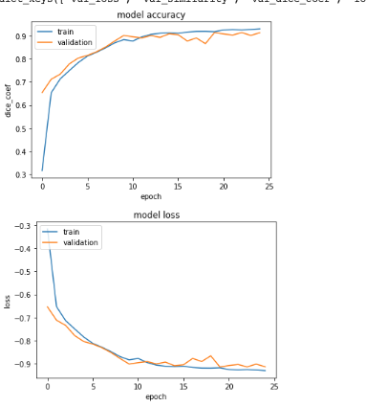
Results from large dataset
Training:
Epoch used: 25/100
Amount of images: 2849
Testing:
similarity: 0.7848005259866679
loss: -0.8760268133638542
dice_coef: 0.8760268133638542
Amount of images: 546

Slide 11
Analysis of findings
Erli is model had a loss of -0.69, David had a loss -.87
Erli dice-coef: 0.6954, David dice-coeff: 0.873
Erli similarity: 0.5540, David similarity 0.782334
Interesting fact: David is model has the training line closer to the validation line
Even when the same amount of cases were used
This can be due to lack of data and different labeling

Slide 12
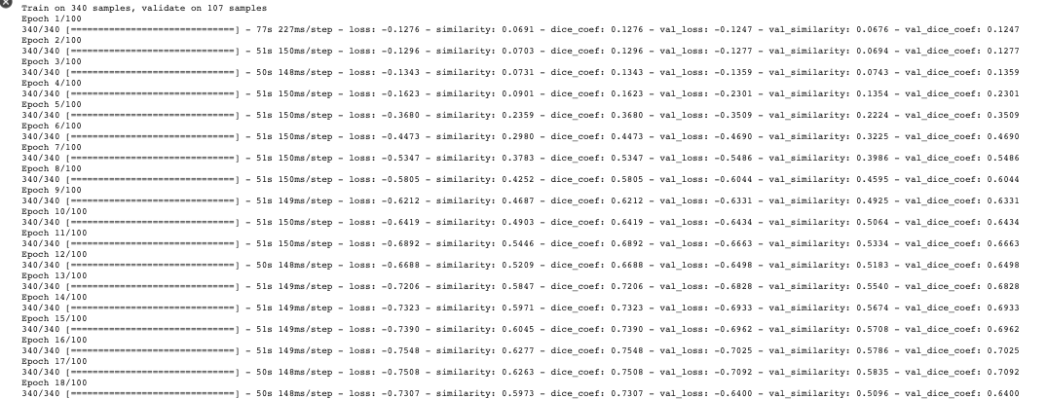
A look at the training

Slide 13
Results of Mini-experiment
Hypothesis: Our results should be slightly different due to human error labeling, but not by much.
Reality: The machine programs learned completely different from each other. Davids model suffered more loss in the beginning and eventually settled towards the end. But, Erli’s model suffered less loss during the majority of the validation stage, instead suffered larger loss towards the end. Both had predictions far below what we expected.
Results: Different styles of labeling can cause varying results for a machine learning algorithm.
Finally, even with variation in the machine is labeling analysis the machine recognition algorithm was still a huge success.

Slide 14
Results of Large Dataset compared to our dataset
Large data: loss -.87, dice coeff: .87 similarity: .78
Erli: loss -.59, dice coeff: .65, similarity .65
David: loss -.87 dice coeff:. 87 similarity: .78
Unexpected result: David is model had the same testing results as the large dataset!
Erli is model trained completely different than both of the models
All models had low similarity rates which we saw to be unusual
Personal opinion: we would like to see more experiments with different parts of the knees in order to see if a contrasting area has similar results or dissimilar results

Slide 15
Mistakes & Errors made during the project
Labeled the same cases because of the order of the files changing after download
Processing error: Certain masks didn’t properly generating requiring relabeling of cases adding 2 hours to the data preparation stage
Runtime errors during model training stage. When generating npy files certain masks were causing issues
Using a CPU instead of a GPU. To generate 5 case file results took over 5 hours.
All in all, the data labeling program is still much faster than labeling by hand.

Slide 16
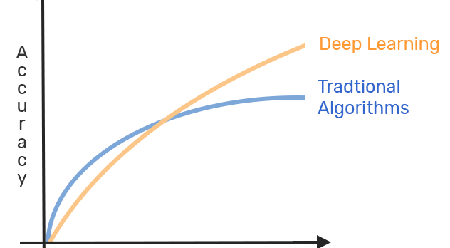
Conclusion
In the end, training the model was a worthwhile investment causing images to be
processed 100x faster and being read at a speed much quicker than a human being can.
The project was a success, but successful enough for the medical field?
This experiment was helpful in understanding power of machine learning.
The difference between deep learning and traditional algorithms are unparalleled.
The amount of work and the results between the two vary dramatically and
have helped mankind make quicker findings during this age of rapid development.
Furthermore, the amount of images an image recognition program can read is impressive.

Slide 17
References
“Convolutional Neural Networks in Python.” DataCamp Community, www.datacamp.com/community/tutorials/convolutional-neural-networks-python.
V-Net: Fully Convolutional Neural Networks for Volumetric Medical Image Segmentation - IEEE Conference Publication, ieeexplore.ieee.org/abstract/document/7785132.

